Slide 1


Single Image Based Face Recognition By Two-fold NN Model for Smart Attendance
_________________________________________________________
COMSATS University, Islamabad

Slide 2
Project Stakeholders :
Saad Alam & Yusra Qayyum
Project Supervisor Name: Mr. Jawad Rafeeq
Final Year Project Committee: Evaluation of project

Slide 3
Key Points
Abstract
Motivation
Problem Statement
Proposed Approach
Related Work
Research Methodology
Product Scope
System Architecture
Functional Requirements
Product Functionality
Tools
References

Slide 4
Abstract
This system:
Identifies and then recognize students using their facial features.
Will record and mark attendance of all the students present in the classroom .
Works on face recognition
Each student in the class is photographed and their details are stored in a server.
The teacher can then record the attendance by just clicking single picture of the classroom.
System will recognize the faces and verify the presence or absence of each student.
Face recognition by using two-fold NN Model which includes Convolution Neural Network (CNN) or any more.

Slide 5
Motivation
Reduce manual process errors by provide automated and a reliable attendance system uses face recognition technology.
Increase privacy
Security
Reduce Proxy
Multiple face detection
Provide methods to maximize the number of extracted faces from a single image

Slide 6
Problem Statement
Why We do Face recognition for Attendance System?
Conventional Method is time consuming.
RFID have the risk of un authorization.
Biometric or Iris is time consuming , which could be because you have to wait in queue.
How our system is better than other?
Less human interaction
Efficient, Time saving ,Simple and Easy

Slide 7
Proposed Approach
The proposed approach in this project is to use a face recognition system to automate the attendance tracking process in classrooms, schools, and universities. The system goes through the following phases:
Face detection: Use Retina-Face algorithm to detect faces in a single image of the classroom
Face recognition: Use Xception deep neural network algorithm to compare the detected faces to the images in the database and identify the students.
Attendance updation: Record the presence of identified students and update the attendance records in an Excel sheet.
Implementation using TKINTER and PYTHON.

Slide 8
Related Work
Shah, K., Bhandare, D. et al. Face Recognition-Based Automated Attendance System. In: Gupta, D., Khanna, A., Bhattacharyya, S., Hassanien, A.E., Anand, S., Jaiswal, A. (Eds) International Conference on Innovative Computing and Communications, 2021.
Khawla Alhanaee, et al. have explained Face Recognition Smart Attendance System using Deep Transfer Learning, Procardia Computer Science, Volume 192, 2021.
Clyde Gomes, et al. have explained: the “Class Attendance Management System using Facial Recognition “which is published in the ITM Web of Conferences in January 2020

Slide 9
Research Methodology
Research Design: The research design adopted for this project is the experimental design.
Data Collection: The data for this project was collected by taking the images of students in a class and using them to create a database.
Evaluation: The system was evaluated using a public student class photo dataset and achieved an accuracy of 99%.
Limitations: The system can be limited by the quality of the image, lighting, and angle of the face.

Slide 10
Product Scope
The main intention of this project is to solve the issues encountered in the old attendance system while reproducing a brand new innovative smart attendance system that can provide convenience to the institution.
The targeted groups of the attendance monitoring system are the students and staff often educational institution.
The facial recognition process can only be done for whole class at a time.
It required no any internet connection.
Using this system we will able to accomplish the task of marking the attendance in the classroom automatically and output is obtained in an excel sheet as desired in real-time.

Slide 11
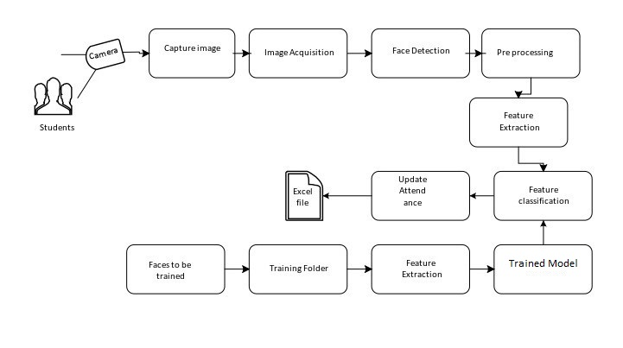
System Architecture

Slide 12
Functional Requirements
Capture Image
Dataset Collection
Image Preprocessing
Segmentation
Classification

Slide 13
Product Functionality
Following are the functions that the user can perform:
Capture image
Verify Attendance
View Attendance Record
Train New Dataset

Slide 14
Product Functionality
Following are the functions that the system can perform:
Performs pre-processing to reduce noisy data.
Apply segmentation.
Classify data using CNN.
Make prediction.
Display results.

Slide 15
Tools
Tools:
Table 2Tools and Technologies for Proposed Project
Tools | Tools | Version | Rationale
 | Spyder | 3.4.5 | IDE
 | MS Word | 2016 | Documentation
 | MS Power Point | 2016 | Presentation
 | Python IP Web Cam | 3.8 | Programming language Camera

Slide 16
References
Poulose, Alwin & Kim, Jung Hwan & Han, Dong. (2021).The Extensive Usage of the Facial Image Threshing Machine for Facial Emotion Recognition Performance. Sensors. 21. 2026. 10.3390/s21062026.
Shah, K., Bhandare, D. et al. Face Recognition-Based Automated Attendance System. In: Gupta, D., Khanna, A., Bhattacharyya, S., Hassanien, A.E., Anand, S., Jaiswal, A. (Eds) International Conference on Innovative Computing and Communications, 2021.
Khawla Alhanaee, et al. have explained Face Recognition Smart Attendance System using Deep Transfer Learning, Procardia Computer Science, Volume 192, 2021.

Slide 17
Clyde Gomes, et al. have explained: the “Class Attendance Management System using Facial Recognition “which is published in the ITM Web of Conferences in January 2020. This paper introduces a new approach to automatic attendance management systems and extended computer vision algorithms.

Slide 18
Thank You

